Slide 1

Health Care Support Worker in Long-term Care
“Mentorship is inspiring others to see the hope in themselves.”
Oprah Winfrey

Slide 2
Session Overview
Long Term Care Philosophy of Care
Mentorship
Welcome to the Learner Role
Limits and Conditions
HCSW Roles and Responsibilities
Program Goals
Engaging and Connecting with Residents
Day in the Life of the HCSW shift responsibilities
Wrap Up
HCA Partnership Pathway

Slide 3
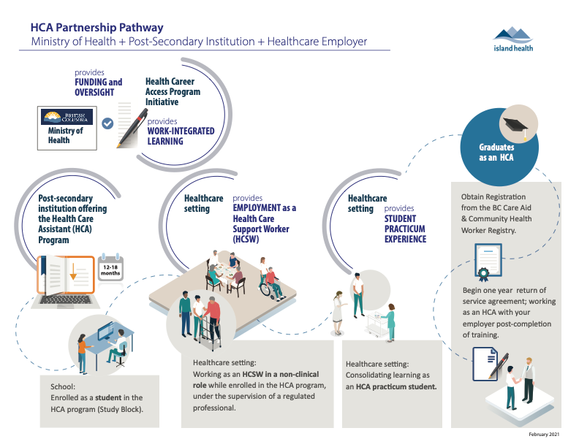

Slide 4
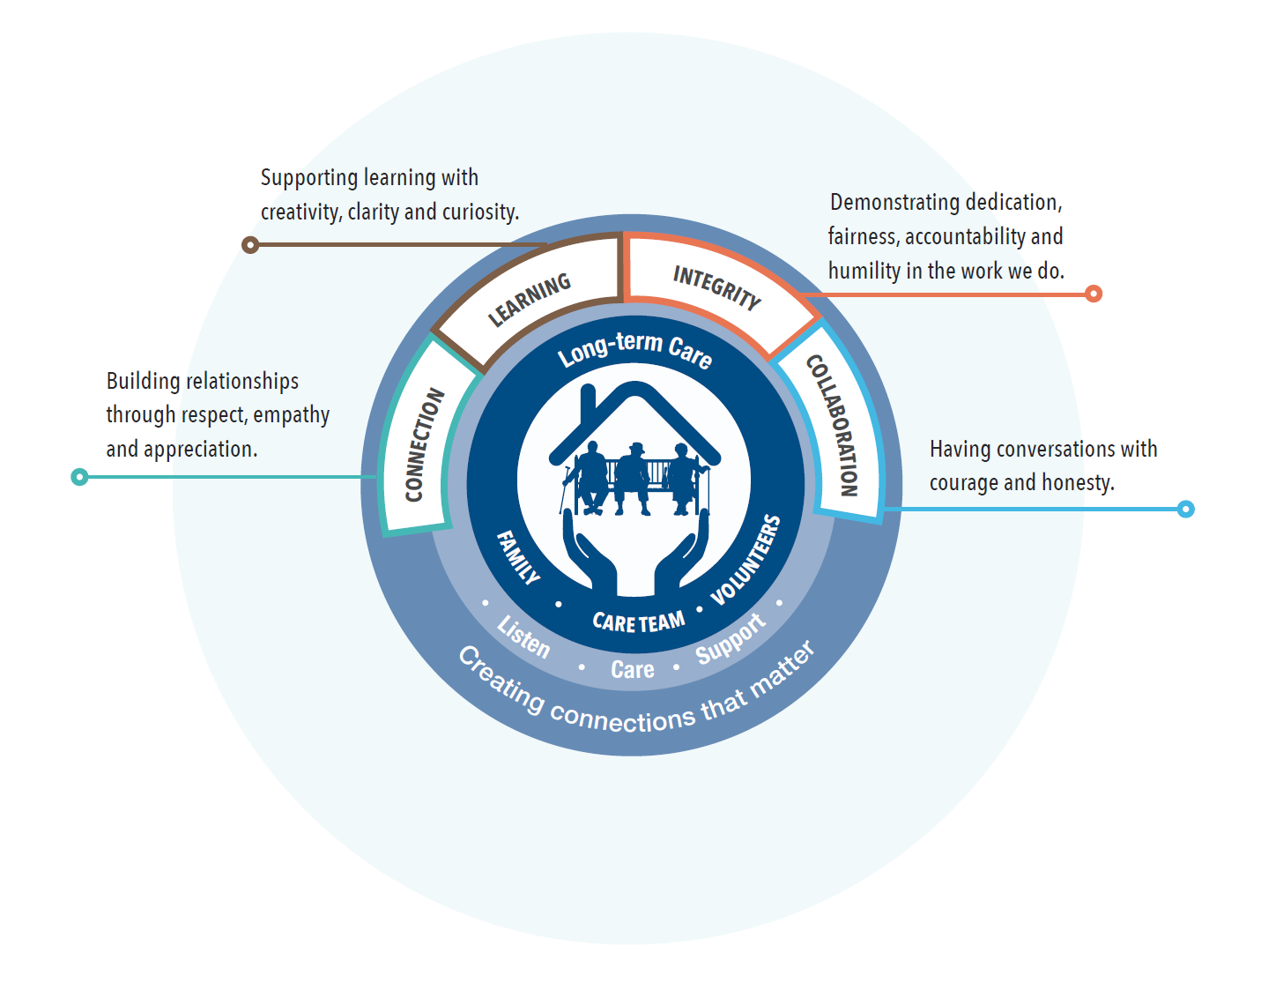
Long-term Care Philosophy of Care

Slide 5
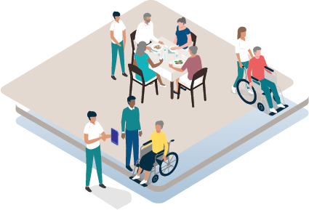
Mentorship
Sharing
Growing
Guiding

Slide 6

Welcome to the Learner Role
Goals based on self-reflection
Responsible for own learning
CORE VALUES
Provide quality care

Slide 7


Being a Learner:
What qualities do you bring to the learner role?
Discuss with your colleagues the qualities that you think you will bring to the learner role.
Write down your examples.
Be prepared to bring your discoveries to the larger group.

Slide 8
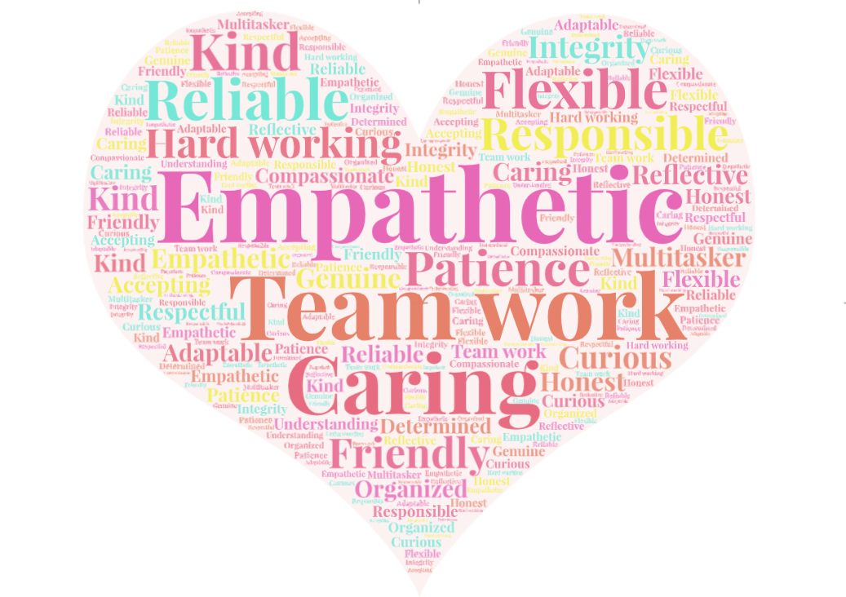
Learner Qualities

Slide 9

Why introduce the new role into Long-term Care?
Increase HCA hires
Enhance residents’ quality of life
Improve entry to health careers
Provide “job ready” graduates

Slide 10

HCSW Role and Responsibilities
Important member of the healthcare team
Connecting and engaging with residents
Providing support and assistance with recreational activities
Restocking supplies

Slide 11

Resources for Mentoring the HCSW
Island Health Limits and Conditions
Peer Mentorship Guide
HCSW Reporting Systems
A Day in the Life of an HCSW

Slide 12
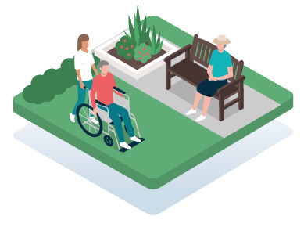

Limits and Conditions
Describes what the HCSW can do

Slide 13


Peer Mentorship Guide
A roadmap that outlines learner and mentor responsibilities
Guides the orientation process

Slide 14
HCSW Support
HCSW
Peer Mentor
MRN
Manager
CNL
Who supports the HCSW?

Slide 15



Engaging and Connecting with Residents
Residents’ Social History
Residents’ Plan of Care
Accompany residents
Set up electronic visits

Slide 16
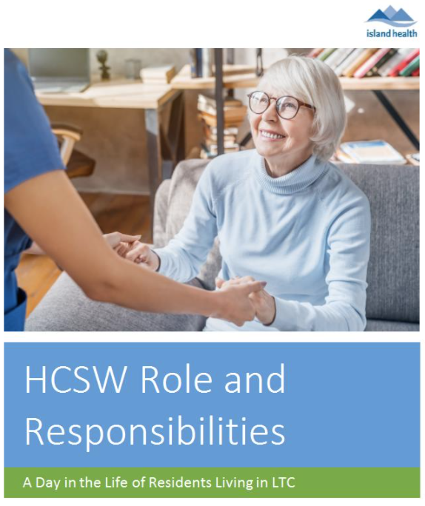
Day in the Life of the HCSW shift responsibilities
An onboarding activity plan

Slide 17

Thank you
Questions and comments

