Slide 1

Peer Mentorship in Long-term Care
“A mentor is someone who inspires others to see the hope in themselves.”
Oprah Winfrey
Notes:
CNE Zoom Administrator will assist with onboarding the Zoom participants.
Allow for 5-10 minute delay.
“I want to acknowledge that we are on the traditional territory of Coast Salish people”. Please take a moment to reflect on this honour and privilege.

Slide 2
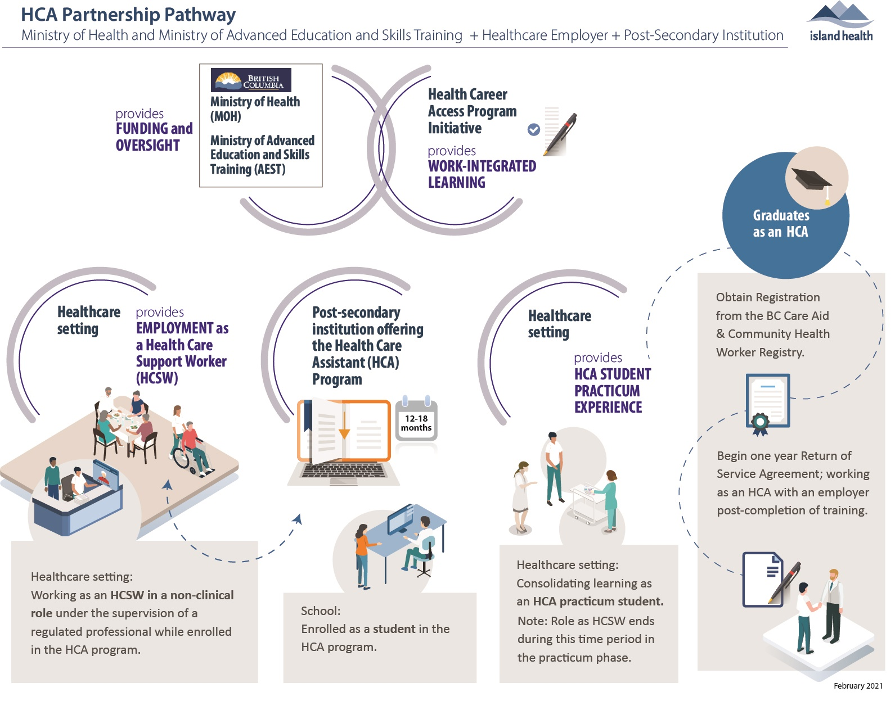
Notes:
I acknowledge, and thank the Coast Salish, LeKwungen, Esquimalt and Songhees nations, for keeping their territory alive and health and for our ability to work and live on these lands,
Acknowledging Traditional Territory is a meaningful and important step on our journey to continuing to increase Island Health’s capacity to provide cultural safe services and environments for Aboriginal peoples

Slide 3

Welcome to the Peer Mentor Role
Guidance and support to build:
Relationships
Experience
Knowledge
Connections
Notes:
Thank you for your kindness in volunteering to support the HCSW learning experience. You play an important part in guiding and supporting the HCSW’s learning while they are present in the care home.
As a mentor, you will develop a relationship with the HCSW where you share your experience, knowledge and connections to support their non-clinical day to day practice.
During the session today, we’ll be learning about being a peer mentor and what specific support HCSWs can offer residents and care team members during their learning experience.

Slide 4
Session Overview
LTC Philosophy of Care
Being a Peer Mentor
HCSW Roles and Responsibilities
Engaging and Connecting with Residents
Day in the Life of the HCSW shift responsibilities
Wrap Up
HCSW Learning Pathway
Cultural Safety
Program Goals: Why Introduce the new role into LTC
Resources for Mentoring the HCSW

Slide 5
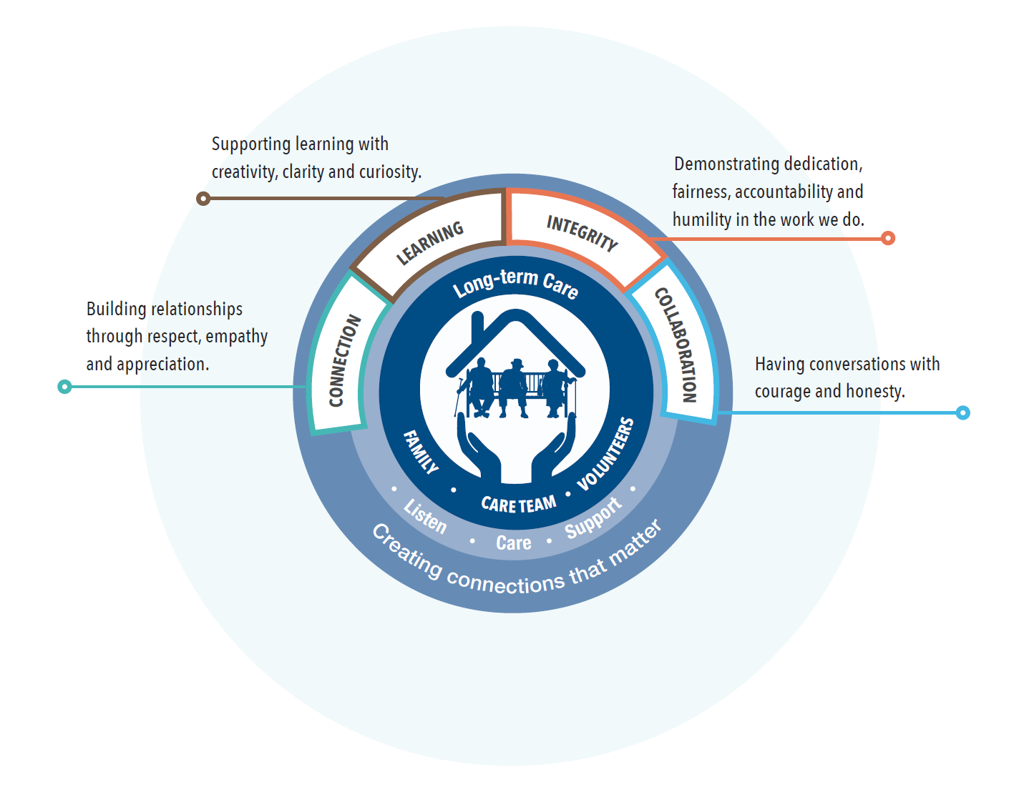
Long-term Care Philosophy of Care
Notes:
Hand out referenced? Do we need to do this?
Let’s begin our session today, with a conversation about the LTC RFCC philosophy of care. These core values guide our understanding that the resident and family are central to all our care and service.
There is a handout in your package.
We care by promoting:
Learning with creativity, clarity and curiosity to grow the care teams for today and the future.
Having the Integrity in recognizing that our future lies in our ability to respond with dedication to forces such as COVID-19 and new care roles such as the HCSW by continuing to provide excellence in resident and family centred care.
Connecting and engaging with residents by promoting relationships as more important than tasks
Collaborating with each other to understand what nurtures the body, mind and spirit
so that the resident has the best day possible.
In your booklets, there is a broader description of RFCC that you can use as your guide.

Slide 6


Cultural Safety is about…
Feeling Respected
Feeling understood
Feeling honoured
Feeling cared for
Feeling that who you are is important
Feeling included in your own care
Feeling safe to share
Cultural Safety is a part of Living Our Values in Island Health.
It is an important aspect of improving the health of the residents we serve, and our aboriginal residents in particular.

Slide 7



Being a Peer Mentor:
What qualities do you bring to the mentorship role?
Discuss with your colleagues the qualities you will bring to the Peer Mentor role?
Write down your examples
Be prepared to bring your discoveries to the larger group
Notes:
Ask participants, “What qualities do you bring to the peer mentorship role”?
Explore qualities in the separate care home groups. After 5-10 minutes.
Bring group together. Discuss their qualities as they are presented by each group.
CNE administrator gathers the qualities on a white board.

Slide 8

Peer Mentor Qualities
Notes:
Show the cloud with mentorship qualities. Describe the mentorship qualities as having:
Respectful attitude, eagerness to help others, ability to give honest and compassionate feedback, reflective listening, empathetic, enjoys seeing others succeed, belief that helping others helps everyone, likes to guide others rather than be the expert, positive outlook, honesty and integrity, believe in the importance of sharing knowledge and experience.
These qualities help LTC care team members flourish in the LTC by encouraging personal growth and satisfaction with supporting a colleague to be an accomplished HCA.

Slide 9


Why introduce the new role into Long-term Care?
Increase HCA hires
Enhance residents quality of life
Improve entry to health careers
Provide “job ready” graduates
Notes:
This role will increase availability of HCA hires during the pandemic.
In the absence of family and volunteers during the pandemic, the HCSW connection and engagement with residents will enhance their quality of life.
This role will improve access to health care careers by providing on the job learning to become a certified Health Care Assistants (HCA).
Supporting the HCSW to be present in the homes, help them build knowledge and skills in a safe environment and generate ‘job ready’ new graduates.

Slide 10

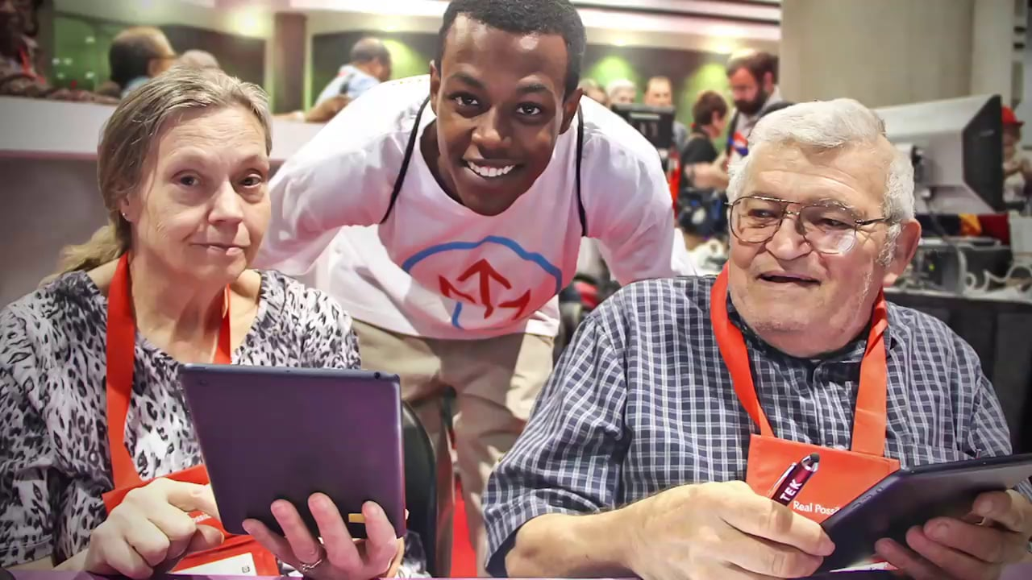
HCSW Role and Responsibilities
Important member of the care team
Connects and engages with residents
Supports and provides assistance
Restocks supplies

Slide 11


Resources for Mentoring the HCSW
Island Health Limits and Conditions
Peer Mentorship Guide
HCSW Reporting Systems
A Day in the Life of an HCSW

Slide 12

Limits and Conditions Resource
Describes what HCSWs can do
Notes:
Purpose is to outline the current Island Health employer limits and conditions for HCSW.
HCSW are not regulated by legislation or govern by a regulartory body therefore they have no legally defined scope of practice.
Ask participants to review to the Island Health Limits and Conditions Health Care Support Worker document.
Review the Limits and Conditions.
Ask what can the HCSW do. Review pages 4-9.
CNE Administrator captures the responses on a white board. Template.
Response: Participate as an Interprofessional Team member, Connect and Engage with residents, Restocking supplies, accompanying residents to meals, activities, therapy, Window and Virtual Visits.
2. Ask participants to review the Peer Mentorship Guide.
“This guide is a roadmap for you and the learner to navigate orientation to the care home”.
As a peer mentor, keeping in mind the qualities of the role; guiding, supporting and debriefing the learner throughout the learning experience. The learner will attend a full day orientation to learn about these documents to prepare them for their experience. You’ll see at the end of each section of the guide that the learner will be reflecting on the responsibilities they have gain competency and those they need to explore further.
3. Reporting Structure: The CNL/CNE/manager/most Responsible Nurse at your home site are available to support you. Don’t hesitate to check in daily.
3

Slide 13
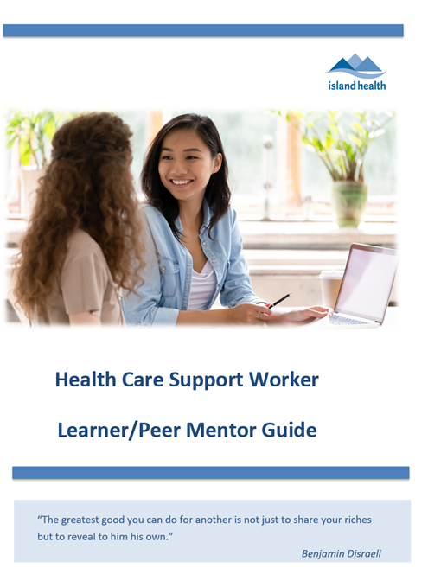

Peer Mentorship Guide
A roadmap that outlines learner and mentor responsibilities
Guides the orientation process
Notes:
The peer mentorship guide is an overview of the practice experiences that you will guide the HCSW in their learning experience.
Please review the guide in your booklet. Within the guide, is the debriefing and reflection items.
Debriefing is an important practice to complete with the HCSW to explore their experiences.
Using the debriefing tips offered in the guide. Let’s practice

Slide 14
HCSW Support
HCSW
Peer Mentor
MRN
Manager
CNL
Who can support HCSWs?
Notes:
Who Do They Go to For Help
Manager
CNL
Peer Mentor
Departmen

Slide 15
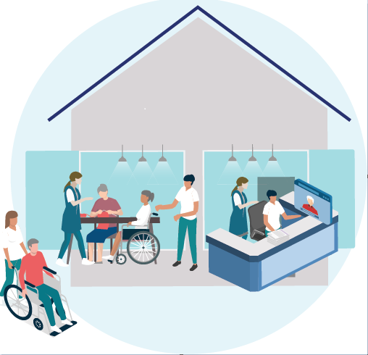
Engaging and Connecting with Residents
Resident Social History
Resident Plan of Care
Accompany residents
Set up electronic visits
Notes:
Resident Social History
Resident Plan of Care
Accompany residents to meals, activities and therapy services
Set up Window/Zoom session

Slide 16
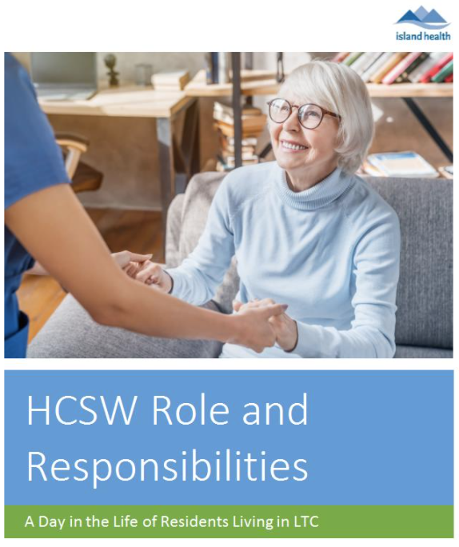
Day in the Life of the HCSW shift responsibilities
An onboarding activity plan
Notes:
This onboarding activity plan will guide you in meeting your learning requirements in supporting residents throughout the day. Your role and responsibilities have been organized into three scheduled shifts 07:00-15:00, 15:00 – 23:00, 23:00-07:00.

Slide 17

Thank you
Questions and comments

